Slide 1

Car Data

Slide 2


Problem:
Which employees will use cars?
Who are our employees?
This involves identifying the employees who are most likely to use cars
Which employees get cars and why do they get cars?
This involves discovering why employees get cars.

Slide 3
What does our data look like?

Slide 4

Data Exploration
The data exploration can be found in the html file attached in the report.
Modeling Considerations
There are missing values in the MBA column, so we have imputed these
We clean the names in the data frame as working with bad names makes coding tedious
The other parts of the exploration are continued in the slides below.

Slide 5
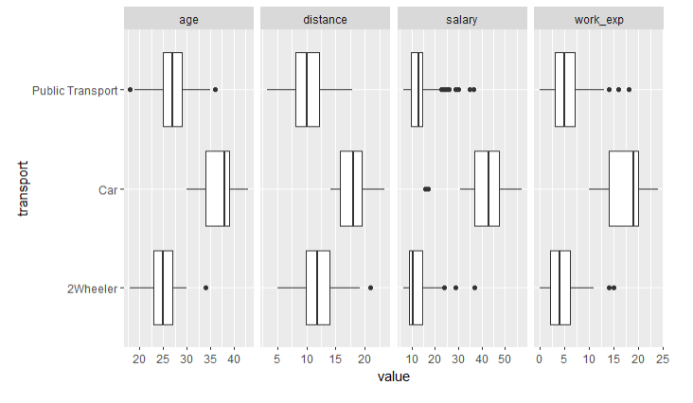

Quick Insights
We can see a clear difference between the employees with cars and those without in terms of the concerned variables.
Employees with cars are generally older, travel a larger distance, earn a higher salary and have more work experience.
This speaks towards the age, salary and the distance being important variables

Slide 6
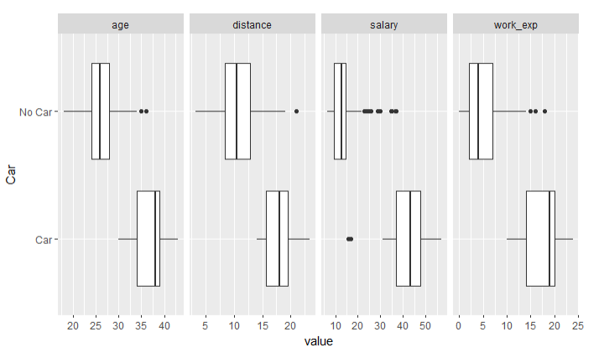
Quick Insights
The transport variable has been converted to a Label column with the values Car or No_Car
The distance, age, salary and work experience can again be seen to important variables

Slide 7
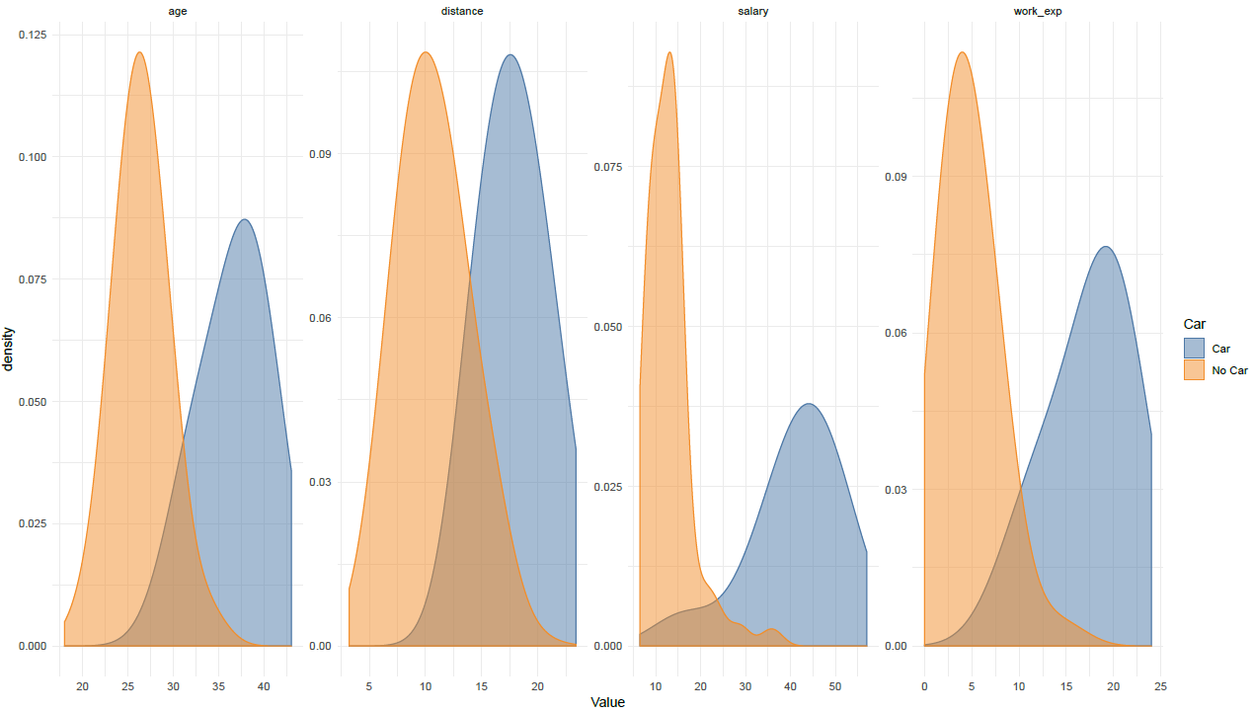
Quick Insights
We can see a clear difference between the employees with cars and those without in terms of the concerned variables.
Employees with cars are generally older, travel a larger distance, earn a higher salary and have more work experience.

Slide 8
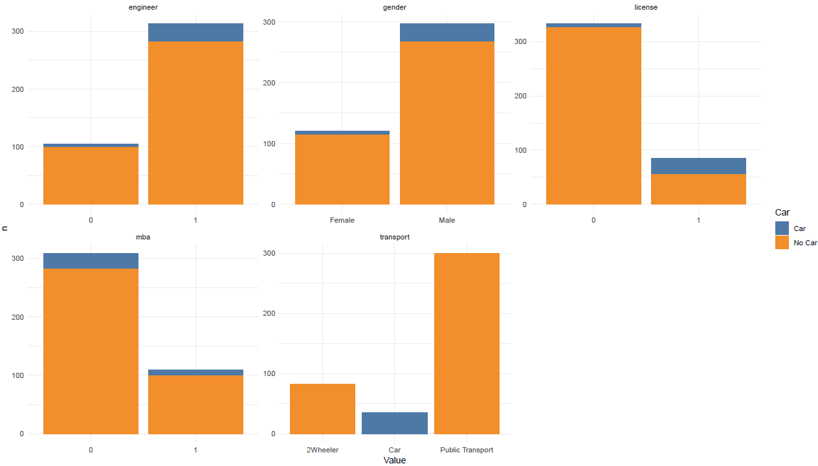
Quick Insights
There are more employees who have no car than those who have a car.
This speaks to class imbalances in our data and we might have to use sampling techniques to balance the classes out for our models.

Slide 9
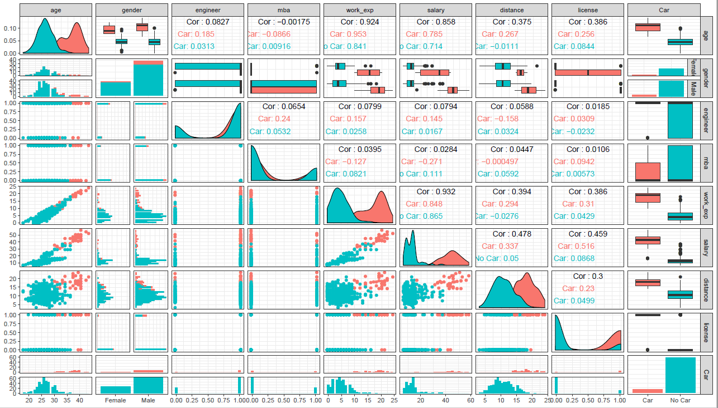

Slide 10
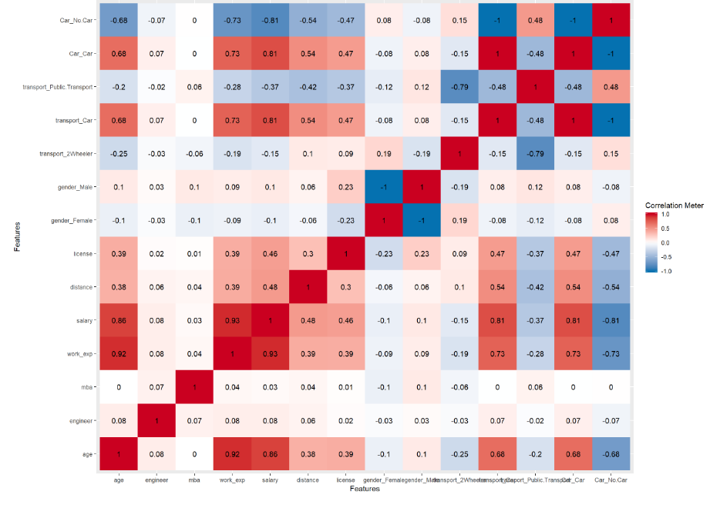
Quick Insights
Some variables are highly correlated to each other. e.g. age is highly correlated with work experience and salary
This speaks towards the existence of multicollinearity in the data and principal components would need to be created.

Slide 11
EDA INSIGHTS

Slide 12
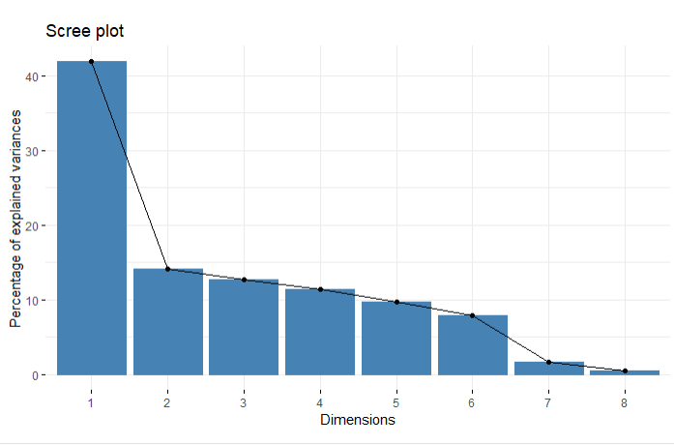
Quick Insights
Some variables are highly correlated to each other. e.g. age is highly correlated with work experience and salary
This speaks towards the existence of multicollinearity in the data and principal components would need to be created.
PCA is run on the data using the FAMD which uses Factor analysis

Slide 13
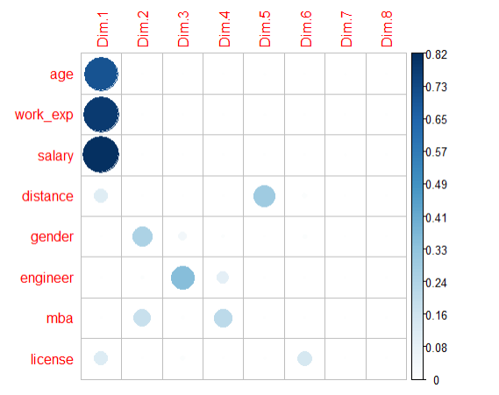
Quick Insights
Some variables are highly correlated to each other. e.g. age is highly correlated with work experience and salary
This speaks towards the existence of multicollinearity in the data and principal components would need to be created.
The first Dimension speaks towards the earning capacity of an individual and is the most important variable
The second-dimension peaks towards whether someone has an MBA and their age
The third dimension speaks towards being an engineer
The fourth dimension speaks towards engineers who have MBA's
The fifth dimension speaks towards the distance traveled to work
Dimension 6 speaks towards having a license

Slide 14
Building the model

Slide 15
Picking the right model
We build five models
KNN
(+) Very simple implementation (+) Robust regarding the search space (-) lazy learner (does not learn from training data but uses the data for classification)
NAÏVE BAYES
(+) Efficient to train (+) highly scalable (-) requires independent predictor features
LOGISITC
(+) Easy to train (+) Efficient to train (-) Black box (-) Takes longer to train
XGBOOST
(+) Regularization (Stops Overfitting) (+) Parallel Processing(-) Black box (-) Takes longer to train
Random Forest
(+) Robust (-) Black box (-) Takes longer to train

Slide 16
Logistic Model

Slide 17
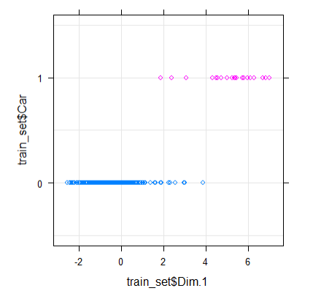
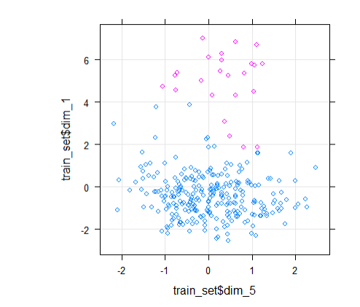
Training results
The model gave fitted probabilities numerically 0 or 1 which means that one of the variables is probably a great separator for the variables.
The inclination is that Dimension 1 is probably the best separator and the plot below shows it
Quick Insights
Dimension 1 is a good separator for the two classes which confirms that the earning power of an individual is the most important variable
The option is to use the brlgm package with regularization or to continue, the modeler chooses simplicity and decides to continue with the modeling without the blrgm packages though it does confirm that the dimension one and dimension 5 are important variables and we can use these two to separate (i.e. the earning power and the distance covered, the plots are shown in plot 2)
Plot 2

Slide 18
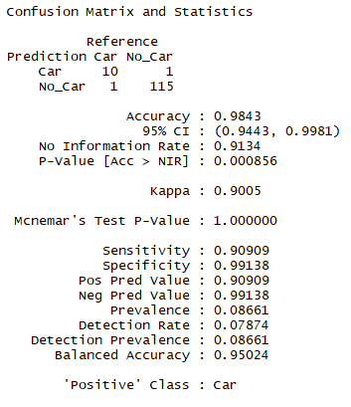
Test results
Quick Insights
Step AIC is used to choose the best model.
The resultant model has highly correlated variables
Two options are possible which are a model with dimension 3 (being an engineer or not) and without variable 5 (distance) or one with the distance variable and one without the engineer variable
The model with the distance variable has a lower AIC and is thus chosen which agrees with the blrgm package output not shown in this case but available in the code

Slide 19
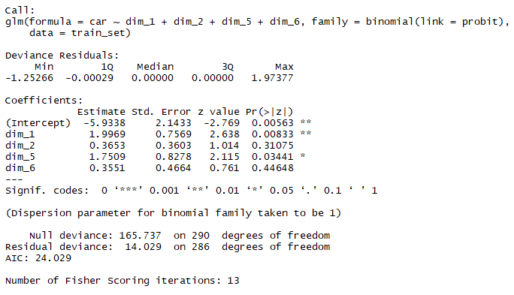
Training results
Quick Insights
The model output of the selected model with dimension 5 and without the dimension 3 is shown

Slide 20
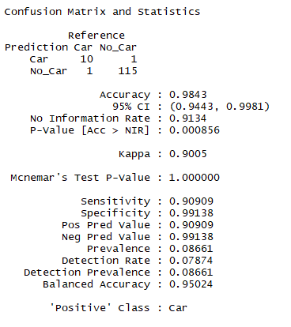
Training results
Quick Insights
The caret package provides a function to find the optimal cutoff and the optimal cutoff produces the same results as the original model
A cutoff which maximizes the sensitivity and specificity is chosen (i.e. minimizes the errors in predicting that someone has a car when they don’t and that they will not have a car when they do)
The imbalanced nature of the data makes 100% prediction difficult and SMOTE might have to be utilized but other methods are explored first as SMOTE might introduce a different distribution to the data and is difficult to use
Another possibility is to remove outliers in the data

Slide 21
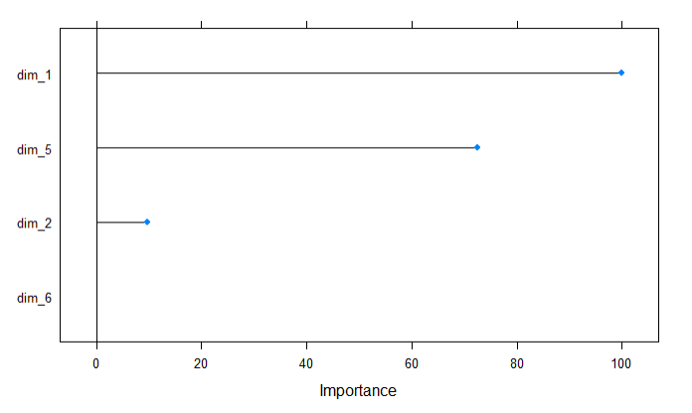
Test results
Quick Insights
The most important variables are the dimension 1 (Earning Capacity) and the dimension 5 (Distance traveled to work)

Slide 22
KNN Model

Slide 23
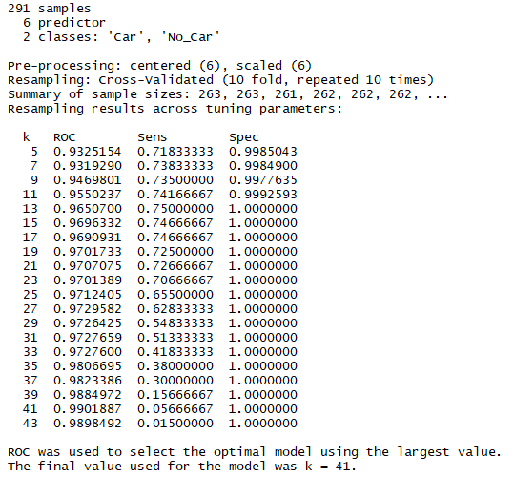
Training results
Quick Insights
The best model chosen based on the ROC is the model with k = 41
The Caret package is used to find the best model

Slide 24
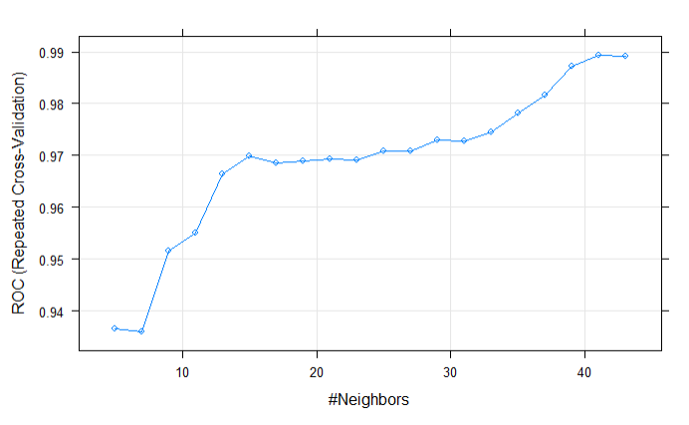
0.0080085
Training results
Quick Insights
The Caret package picks the KNN model with K = 41 as the optimal model with the highest ROC
The modeler chooses not to plot the ROC curve

Slide 25
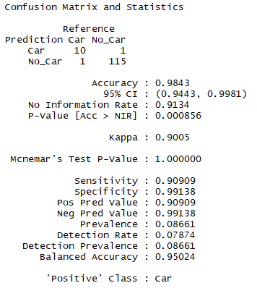
Test results
Quick Insights
The most accurate model chosen during training misclassifies 1 Car owning individual as not owning a car and a single individual not owning a car as owning a car
This speaks towards the imbalance in the classes in the data and SMOTE or variable capping might need to be used as shown by the x vs y plot shown in the EDA

Slide 26
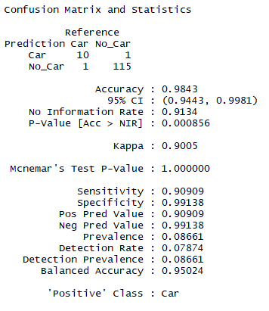
Test results
Quick Insights
The caret package threshold search is used to pick the model with the highest specificity and sensitivity combination
This model performs the same as the initially chosen model

Slide 27
Naïve Bayes Model

Slide 28
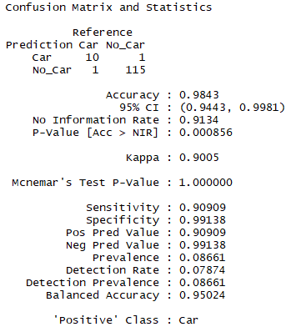
Test results
Quick Insights
A Naïve Bayes classifier is trained using the Caret hyperparameter search function
The Naïve Bayes is biased towards the best guess is the majority class which is the case with our dataset as it imbalanced but the solution space separation should be good enough to give us an accurate model even though the data is imbalanced

Slide 29
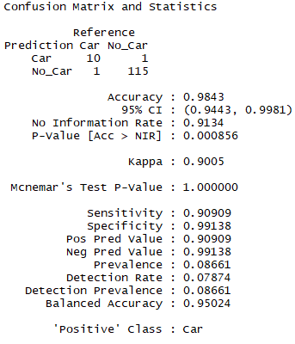
0.0080085
Test results
Quick Insights
The caret package threshold search is used to pick the model with the highest specificity and sensitivity combination
This model performs the same as the initially chosen model
The cutoff is chosen at a value of 0.48

Slide 30
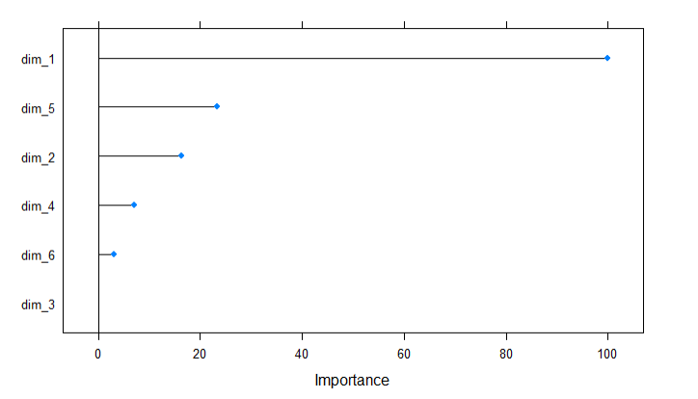
Test results
Quick Insights
The most important variables are the dimension 1 (Earning Capacity) and the dimension 5 (Distance traveled to work)
The gender and whether a person has an MBA is also a useful variable

Slide 31
XG Boost Model

Slide 32
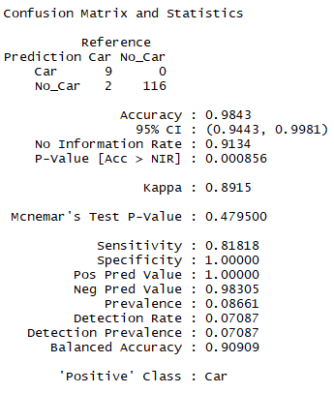
Test results
Quick Insights
An XG boost classifier is trained using the Caret hyperparameter search function

Slide 33

Test results
Quick Insights
The mlr package threshold search is used to pick the model with the highest specificity and sensitivity combination
This model performs the same as the initially chosen model
This speaks to the need for outlier removal

Slide 34
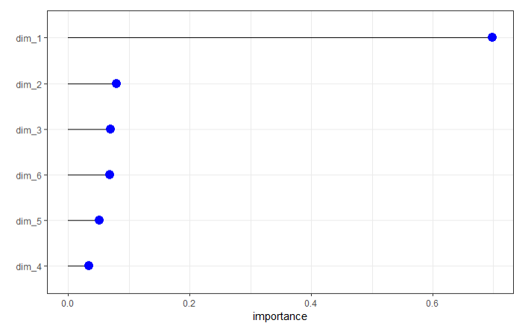
Test results
Quick Insights
The most important variable is the dimension 1 (Earning Capacity

Slide 35
Random Forest Bag Model

Slide 36
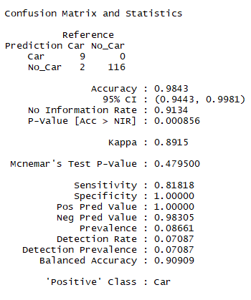
Test results
Quick Insights
A random forest bagging classifier is trained using the Caret hyperparameter search function

Slide 37

Test results
Quick Insights
The mlr package threshold search is used to pick the model with the highest specificity and sensitivity combination
This model performs the same as the initially chosen model
This speaks to the need for outlier removal

Slide 38
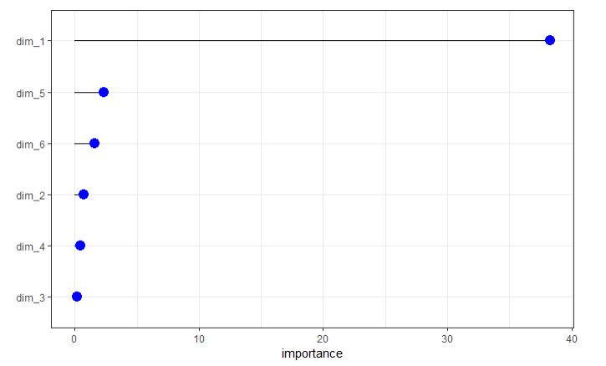
Test results
Quick Insights
The most important variables are the dimension 1 (Earning Capacity) and the dimension 5 (Distance traveled to work)

Slide 39
Comparing the models

Slide 40
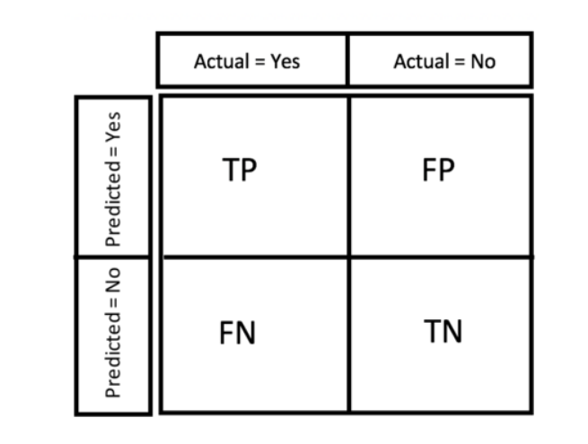
Analyzing the results
Confusion Matrix
Metric Considerations
The point of the model is to make the best prediction of the individuals who have cars
This means that we want to minimize the number of people we wrongly predict to have cars (false positives) and reduce the false negatives as well (i.e. people we predict to not have cars)
Because of the highly imbalance nature of the data and the fact that there are more people who do not have cars, we need to choose the model that has the lowest false positive rate.

Slide 41
Comparing results
Logistic Regression
Naïve Bayes
KNN Model
Reference
Reference
Reference
Quick Insights
 | Car | No Car | Error | Error%
Car | 10 | 1 | 1/11 | 9.10%
No Car | 1 | 115 | 1/116 | 0.86%
Total | 11 | 116 | 2/117 | 1.7%
 | Car | No Car | Error | Error%
Car | 10 | 1 | 1/11 | 9.10%
No Car | 1 | 115 | 1/116 | 0.86%
Total | 11 | 116 | 2/117 | 1.7%
 | Car | No Car | Error | Error%
Car | 10 | 1 | 1/11 | 9.10%
No Car | 1 | 115 | 1/116 | 0.86%
Total | 11 | 116 | 2/117 | 1.7%
We choose the Naive Bayes model as it is highly scalable and easy to train and has the lowest error
In this case we choose the simplest model which is the Naïve Bayes model
The most important variables are the Earning capacity of an individual as well as the distance traveled to work
Capping at the 99% and 1% level does not improve results so the results will be taken as is
Prediction
Prediction
Prediction

Slide 42
Conclusion

Slide 43
Conclusion
We choose the Naïve Bayes model as it is the most accurate
The most important variable sin degerming whether an individual has a car or not are the earning capacity of an individual and the total distance that they travel to work
If a person has a high earning capacity and travels a large distance, they are thus more likely to have a car
There are a few outliers who will still have a high earning capacity and travel a large distance even though they do not

Slide 44
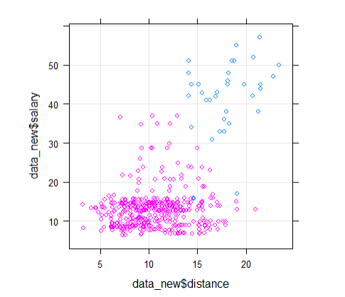
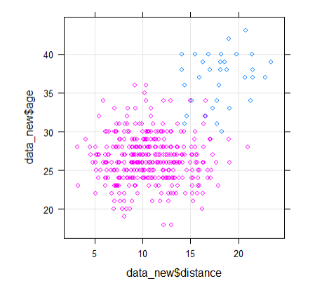
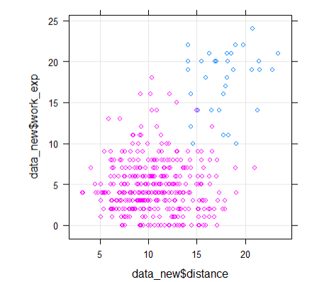
Conclusion
Therefore if a person earns above 30 000 a year and if the distance from the office is over 14km from the office and they are above 34 years old and they have more than 15 years work experience they are likely to have a car

